Slide 1
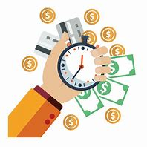
Expense Tracker

Slide 2
Content
Introduction
Problem Statement
Objective
Requirement Analysis
System Design
Future Scope
Conclusion

Slide 3
Introduction:
In today's dynamic and fast-paced world, effective financial management is crucial for individuals and businesses alike. One of the key aspects of financial management is keeping track of expenses, which can often be a challenging task. The introduction of our Expense Tracker aims to provide a robust solution to this challenge, offering users a streamlined and efficient way to monitor and manage their expenditures.
The Expense Tracker application is a full-stack web application built using the MEAN stack, which includes MongoDB, Express.js, AngularJS, and Node.js. This application allows users to create an account, log in and log out, and track their expenses by creating, reading, updating, and deleting them.

Slide 4
Problem Statement
At the end of the month we start to have money crisis;
Lack of proper planning of our income
Person has to keep a log in a dairy or in a computer;
All the calculations needs to be done by the user;
Overload to rely on the daily entry of the expenditure.

Slide 5
Objectives
The main objective of an expense tracker is to provide users with a clear and organized view of their expenses. By using an expense tracker, users can:
To know where the money is going
To spend only on priorities
To save money for pre-defined expenses
To plan on your future investments

Slide 6
Requirements Analysis
Functional Requirements
Dashboard panel
Add bill
Expense tracker
Expense planner
Non functional Requirements
Non functional Requirements
Usability
Reliability
Supportability
Performance
Availability

Slide 7
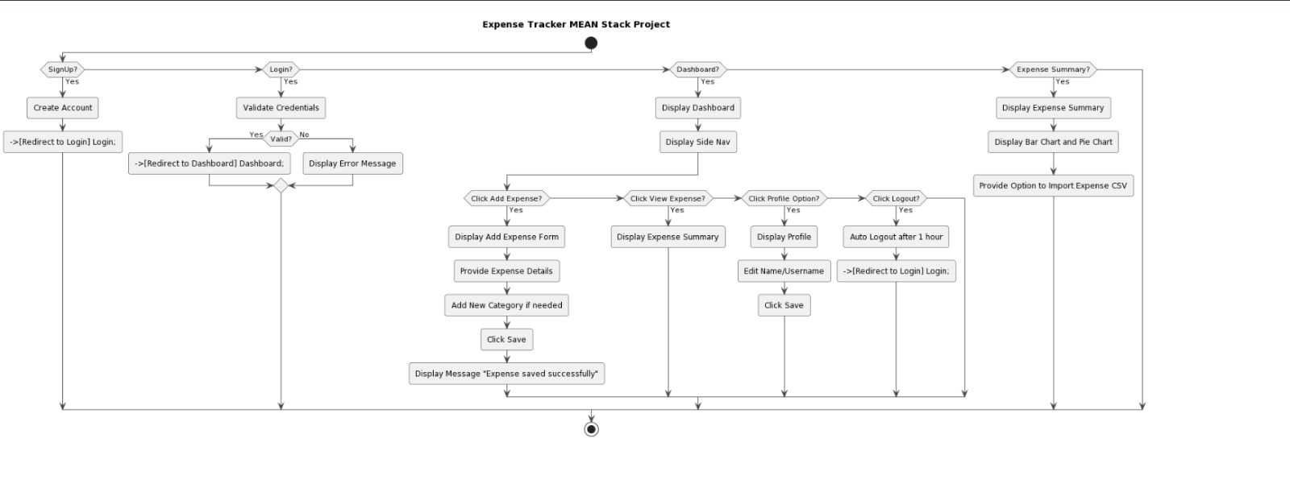
System Design

Slide 8
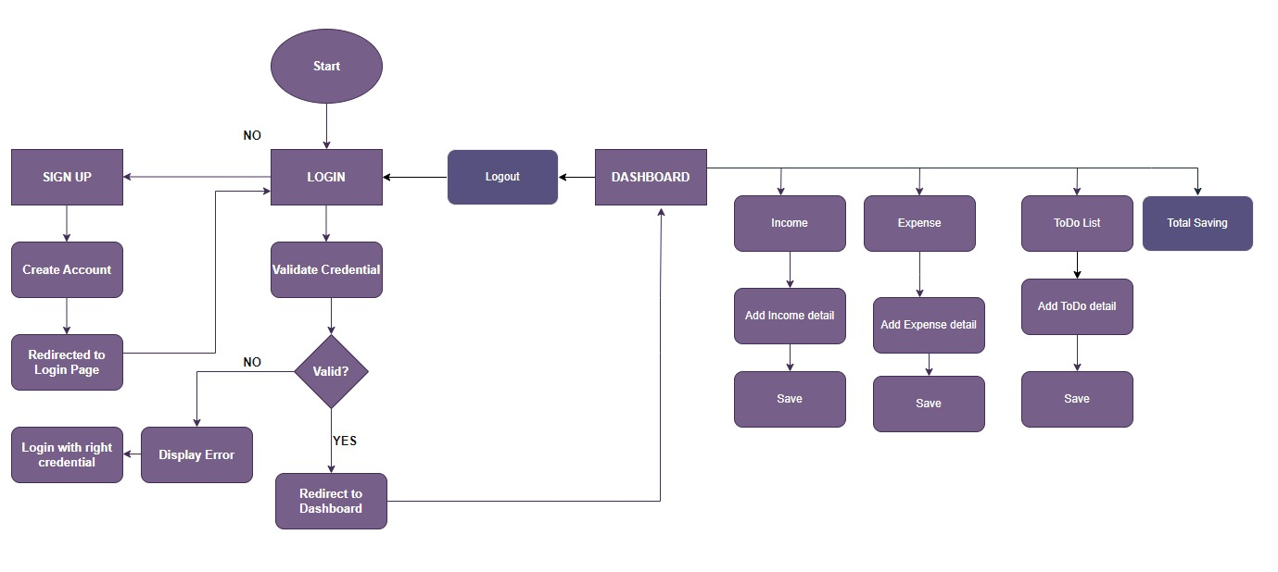
ER Diagram

Slide 9
Future Scope
We assure that this will help users to manage the cost of their daily expense
Helpful for the people who are frustrated with the daily budget management
Wish to manage money
Preserve the record of their daily cost
Overcome wastage of money

Slide 10
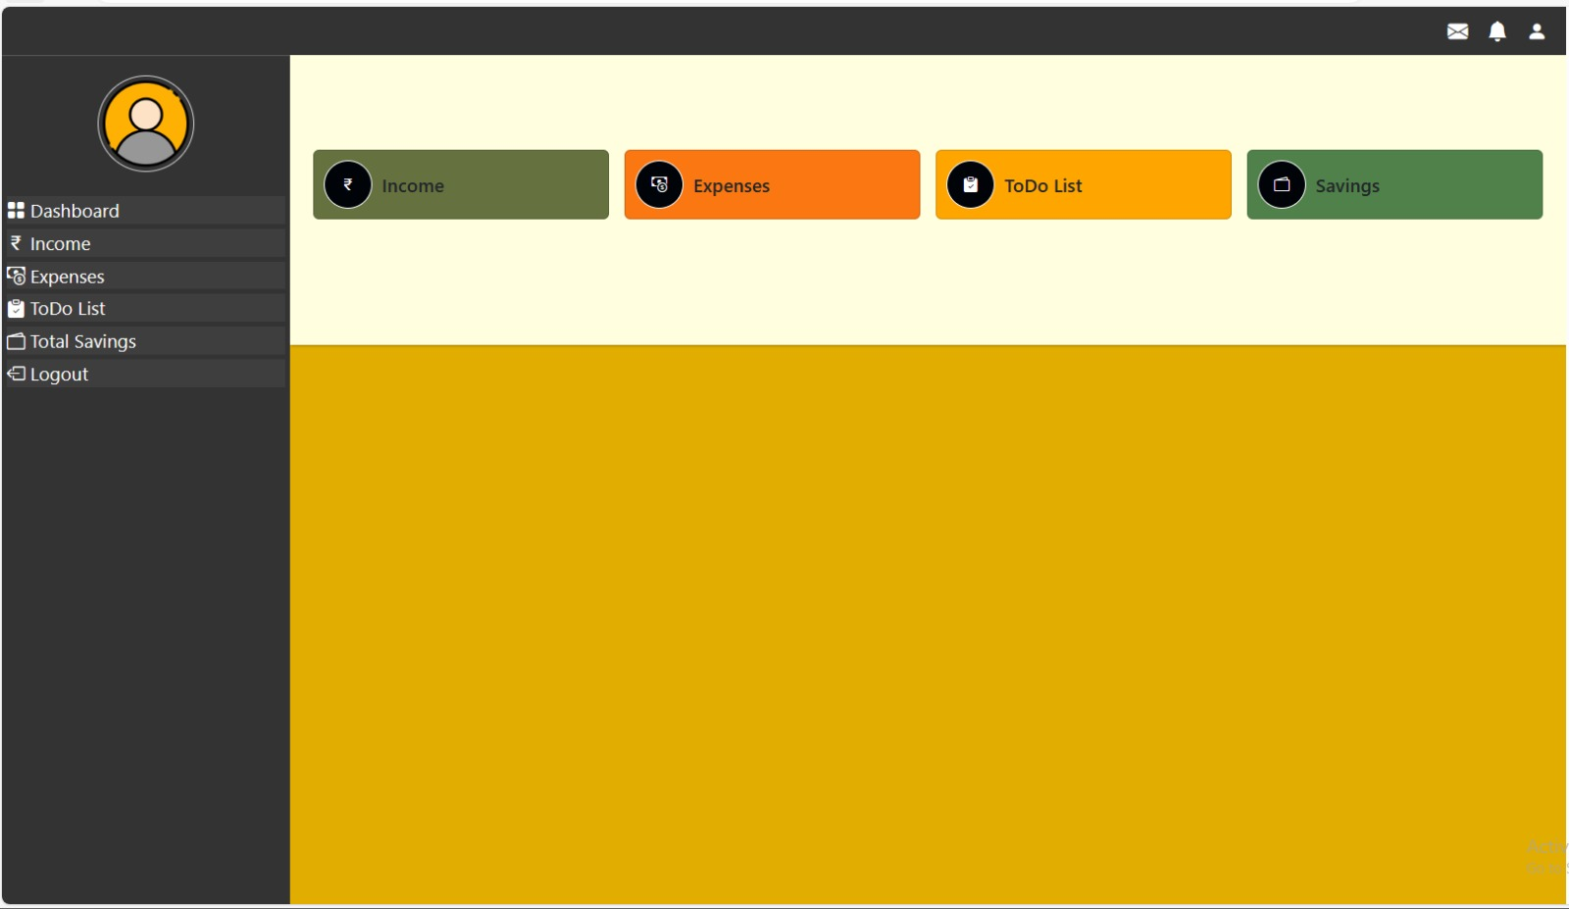
OUTPUT

Slide 11
Prepared by : Team MEANiacs
Team Members:
1. S K Rajesh
2. Riya Sharma
3. Hena Dhawa
4. Nishat Perwez

Slide 12
THANK YOU

